Slide 1
Study for Observation CAR 163916865 – AP Team A
 | Team Review Criteria - Observations | Presented by
1 | ·Explain how/If the analysis supports the root cause statement | Catherine
2 | ·Based upon the root cause, should the severity of the CAR be changed such that it should now be classified as a Finding? If so, fully explain | Larisa
3 | ·Explain why/If the evidence in the milestones was sufficient to confirm that the nonconformity was eliminated | JY

Slide 2
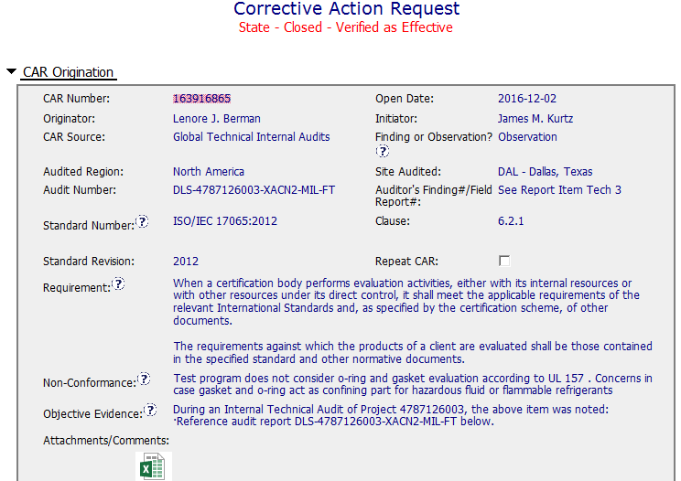
CAR# 163916865

Slide 3
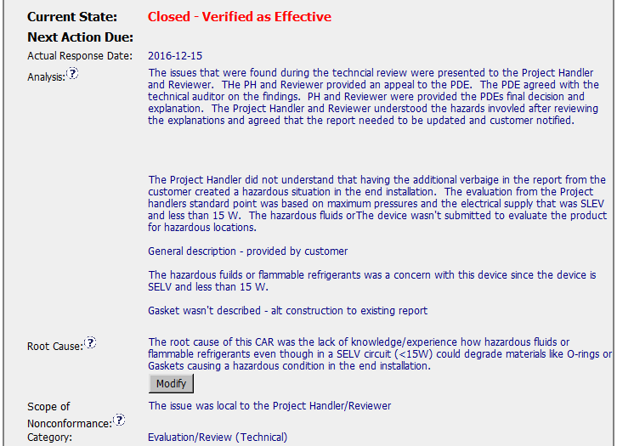
CAR# 163916865
By Catherine
 | Team Review Criteria - Observations
1 | ·Explain how/If the analysis supports the root cause statement
Notes:
Highlight key points for below criteria:
•Explain how/If the analysis supports the root cause statement

Slide 4
CAR# 163916865
1. Explain how/If the analysis supports the root cause statement
Comments:
The analysis described the background of this issue, and stated PH didn’t understand the standard requirement.
Root cause mentioned the lack of knowledge/experience, the analysis just partially supports the root cause statement.
There should be more deep analysis to do, to ask why PH and Reviewer have the lack of knowledge/experience, may no training, or something else.
If PH and Reviewer has the lack of knowledge/experience, the scope of nonconformance should be investigated to see this issues impact an individual project, or other projects handled by the PH and reviewed by the Reviewer.
In the other hand, the analysis mentioned PH, reviewer didn’t understand the standard requirement, it impacts on the certification decision, it’s a serious issue, the CAR may be classified to Finding.
Notes:
Highlight key points for below criteria:
•Explain how/If the analysis supports the root cause statement

Slide 5
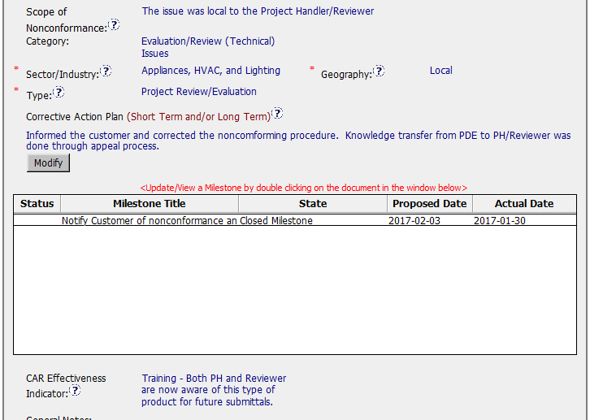
CAR# 163916865
By Larisa
2 | ··Based upon the root cause, should the severity of the CAR be changed such that it should now be classified as a Finding? If so, fully explain
Notes:
Highlight key points for below criteria:
·Based upon the root cause, should the severity of the CAR be changed such that it should now be classified as a Finding? If so, fully explain

Slide 6
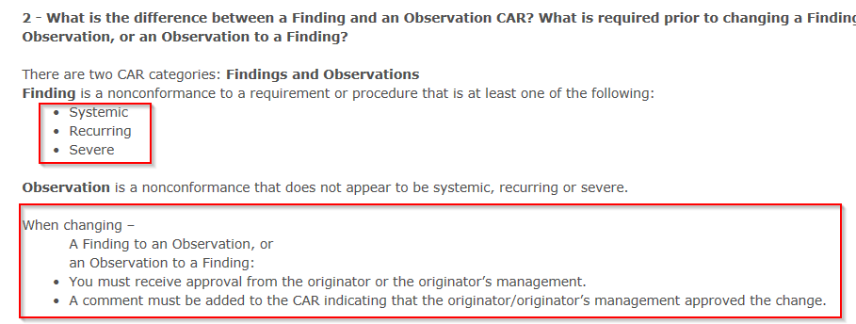
CAR# 163916865
2. Based upon the root cause, should the severity of the CAR be changed such that it should now be classified as a Finding? If so, fully explain
As a reminder -
Notes:
Highlight key points for below criteria:
·Based upon the root cause, should the severity of the CAR be changed such that it should now be classified as a Finding? If so, fully explain

Slide 7
CAR# 163916865
As a general rule - CAR Champion cannot change CAR from Observation to Finding on Root Case alone, as first step, this needs to be discussed and agreed upon with CAR originator/originator’s manager. Also, this approval needs to be documented in the CAR
In this particular instance, since there are indications that issue could be potentially systemic, recurring and severe, CAR Champion can discuss with CAR originator/originator’s manager whenever more thorough Analysis may be deemed necessary
If CAR’s originator/originator manager’s agree that more thorough Analysis is needed and analysis results provide objective evidence that issue is systemic, recurring and severe and CAR originator/originator manager agree that CAR from Observation to Finding, then CAR can be changed from Observation to Finding with comment added to the CAR that indicating that the originator/originator’s management approved the change
Notes:
Highlight key points for below criteria:
·Based upon the root cause, should the severity of the CAR be changed such that it should now be classified as a Finding? If so, fully explain

Slide 8
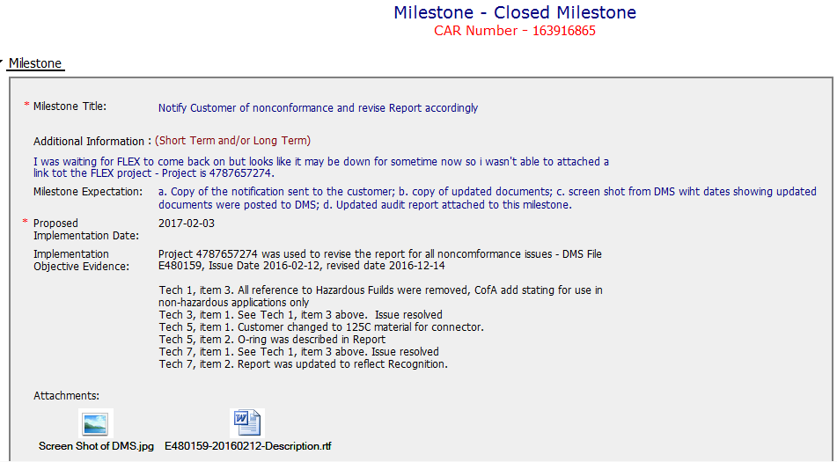
CAR# 163916865
If this is still qualified as Ob, then the milestone was sufficient to confirm the non-conformity was eliminated. However, if this could be systematic after deep and thorough analysis, more milestone may be necessary.
By JY
3 | ·Explain why/If the evidence in the milestones was sufficient to confirm that the nonconformity was eliminated
Notes:
Highlight key points for below criteria:
•Explain why/If the evidence in the milestones was sufficient to confirm that the nonconformity was eliminated

Slide 9
CAR# 163916865 – CAR Review Criteria Check
CAR Review Criteria | Fully | Partially | Not at all | N/A
•Does the analysis support the Scope of Nonconformance statement? |  | √
•Based upon the root cause, should the severity of the CAR be changed such that it should now be classified as a Finding? | √
•Was the evidence in the milestones sufficient to confirm that the nonconformity was eliminated?? | √

